Slide 1
IPCC Chapter 04: Mitigation and development pathways in the near- to mid-term
Presented By: Enakshi Das

Slide 2
WHAT MY CHAPTER IS ABOUT?

Slide 3
WHERE ARE WE HEADING NOW?
Despite the drop in emissions due to the COVID-19 crisis, the gap between projected emissions based on Nationally Determined Contributions (NDCs) in 2030 and emissions pathways compatible with the long-term temperature goal set in the Paris Agreement remains large. In addition to this persistent emissions gap, we face an implementation gap, as current policies are insufficient to achieve mitigation targets in NDCs, and sufficient international support is not yet available to developing countries who have requested and quantified support needs. Continuing along a development pathway characterized by the same underlying drivers, structural obstacles and insufficient enabling conditions that led to high emissions will not address the problem.

Slide 4
WHERE DO WE WANT TO GO?
Technical alternatives and policy options exist to bridge the emissions and implementation gaps, and the literature illustrates these with a wide range of accelerated techno-economic pathways that deepen decarbonisation closer to the pace and scale required, and examines their impacts on other development objectives. In practice, however, scaling up at the broader, deeper, and faster level required to meet climate goals while advancing other development objectives regularly faces prohibitive obstacles.
Mitigation policies grafted on to existing development pathways are unlikely to achieve rapid and deep emission reductions. Secondly, even if carefully designed, climate policies to accelerate mitigation may have adverse consequences for other development objectives. As a complement to mitigation action, taking action to shift development pathways towards sustainability broadens the range of mitigation options, while increasing the possibility to meet other development priorities at the same time.

Slide 5
HOW CAN WE ACCELERATE MITIGATION?
Deliberate measures taken to facilitate the shifting of development pathways and accelerated mitigation involve, putting in place key enabling conditions that help overcome those obstacles.
improving governance and institutional capacity
fostering behavioural change and technological innovation
designing and implementing adequate policy and finance.
Since development pathways and mitigation options depend to large extent on national objectives and circumstances, this chapter is primarily concerned with literature at national level.

Slide 6
WHAT IT CONTAINS TECHNICALLY?

Slide 7
Chapter 4 draws on five major strands of literature:
On development pathways: conceptual & empirical including at the national and sub-national scales
Rapidly expanding, model-based, literature on mitigation pathways in the near-mid term
Studies of NDCs and mid-century strategies
On transformation and shifts in development pathways, including from non-climate literatures
IPCC/AR6/WG3/Chapter04
On equity, including just transitions

Slide 8





AT A GLANCE
Section Headings: This chapter contains 6 main sub-sections
FAQs: This chapter has 3 frequently asked questions at the end
Executive Summary: This Chapter has an Executive Summary with 10 take-aways
Tables: There are a total of 12 tables in this chapter.
Images: There are 9 images in this chapter

Slide 9
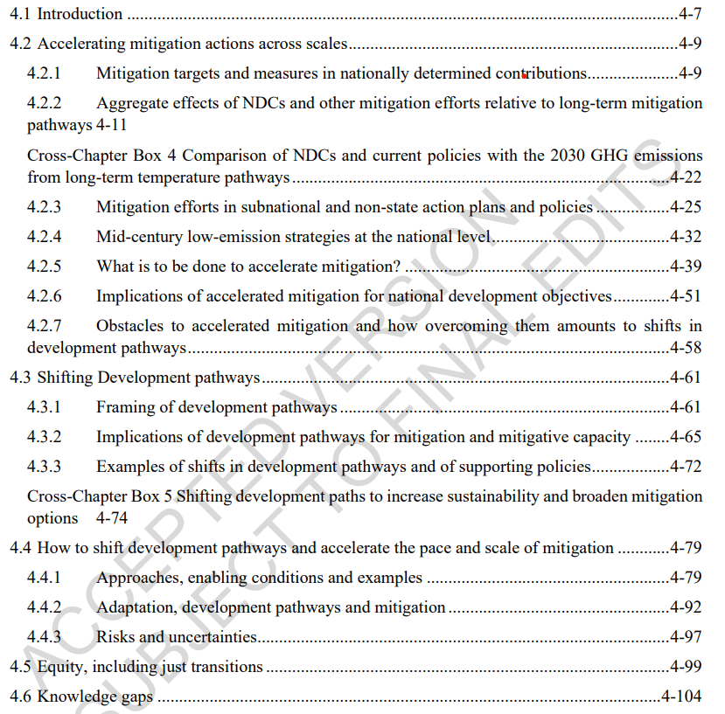
SECTION HEADINGS

Slide 10
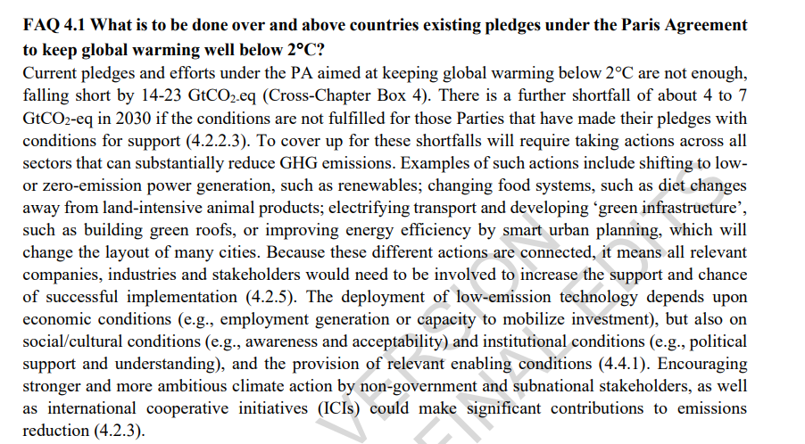
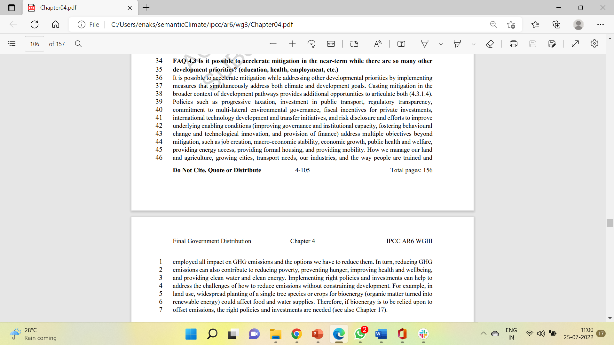
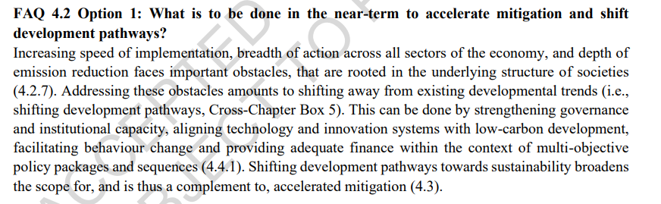
Frequently Asked Questions
1.
3.
2.

Slide 11
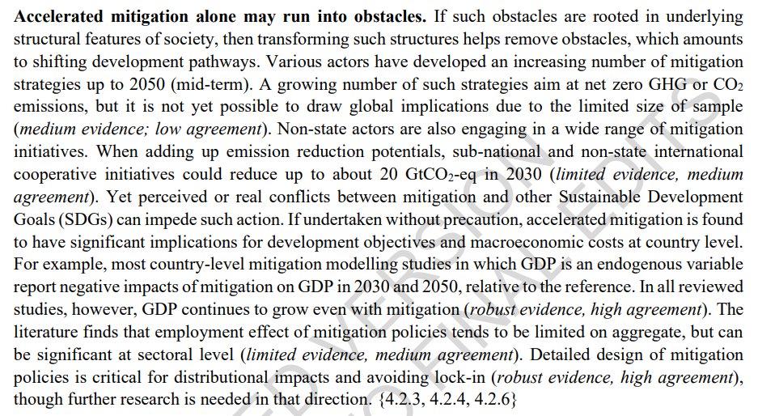
EXECUTIVE SUMMARY

Slide 12
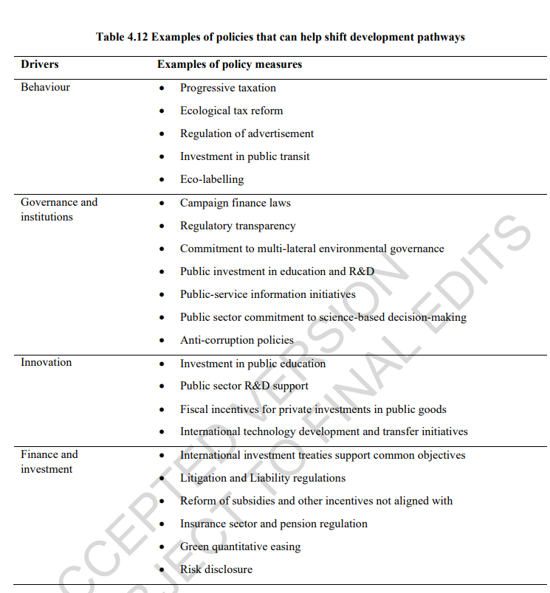
KEY TABLE

Slide 13
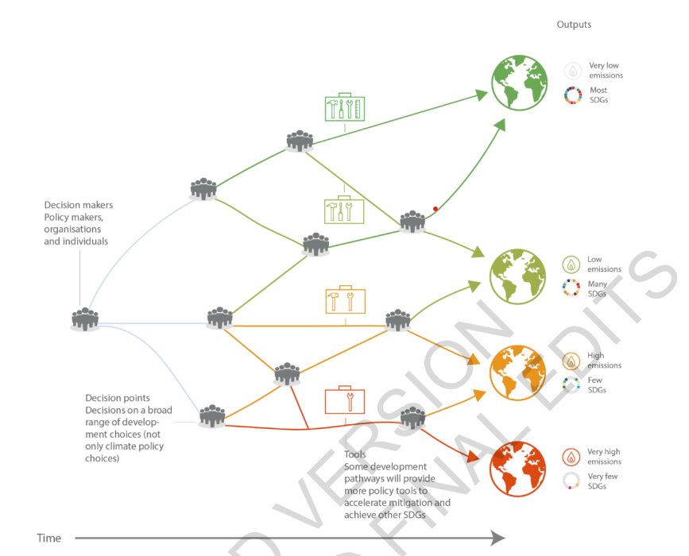
IMAGES
Figure 4.7 Shifting development pathways to increased sustainability: Choices by a wide range of actors 3 at key decision points on development pathways can reduce barriers and provide more tools to accelerate 4 mitigation and achieve other Sustainable Development Goals

Slide 14





PROJECT OUTLINE
PDFs:
Hard to read
Can’t be formatted
Very Lengthy
Use of difficult terms
Unreadability
PDF to HTML
Image Extraction
Text Extraction
Abbreviations

Slide 15
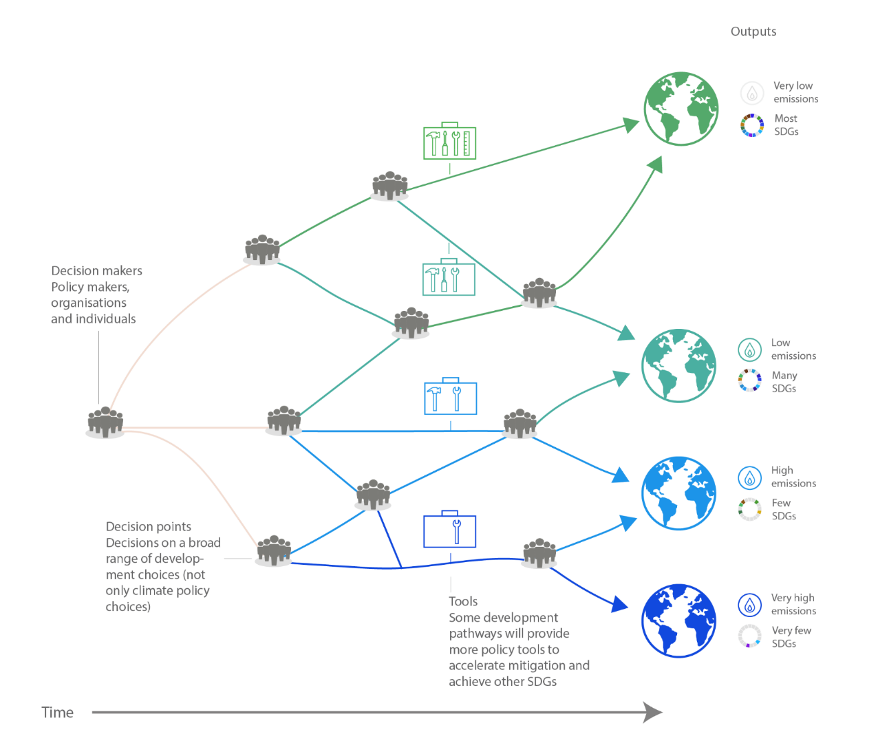
EXTRACTED IMAGES
Figure 4.7 Shifting development pathways to increased sustainability: Choices by a wide range of actors 3 at key decision points on development pathways can reduce barriers and provide more tools to accelerate 4 mitigation and achieve other Sustainable Development Goals

Slide 16
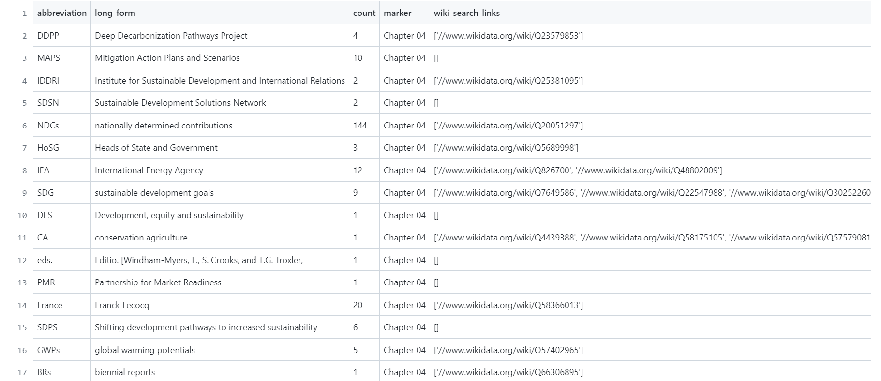
ABBREVIATION LIST
This chapter contained approximately 59 abbreviations, for which we also found the count and the Wikidata Search Links.

Slide 17
THANK YOU

